Slide 1
Install IntelliJ IDEA Community Edition with Scala plugin
Functional Programming Principles in Scala: IntelliJ IDEA Tutorial

Slide 2
1. Download IntelliJ IDEA Community Edition
IntelliJ IDEA Community Edition is an open-source version of IntelliJ IDEA, a premier IDE for Java, Scala and other JVM-based programming languages. You can download it from the official website: http://www.jetbrains.com/idea/download

Slide 3
2. Install Scala plugin
Before you create or open a Scala project, you need to install the Scala plugin. For that, use the Configure → Plugins → Browse JetBrains Plugins from the Welcome Screen, or Preferences (Settings) → Plugins.
Note that Scala plugin requires restart to complete installation.

Slide 4
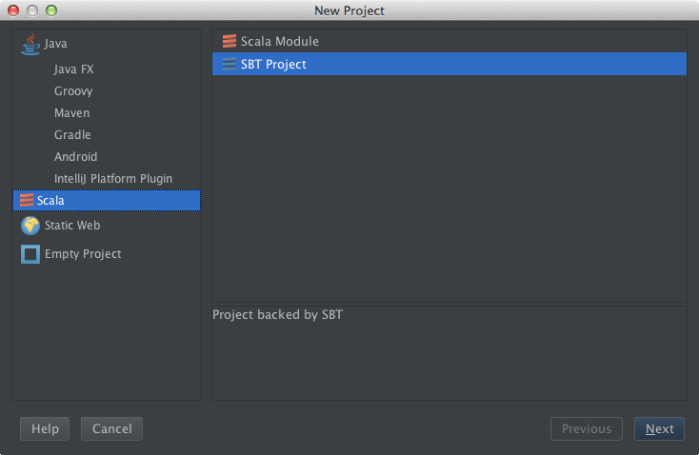
3. Setup the JDK and Creating a project
From the welcome screen, go to Configure → Project defaults → Project structure and add the JDK.
The easiest way to create a project is to use the Project Wizard. To use it, Click Create New Project on the Welcome Screen, then select Scala, and finally SBT Project.
Click Next to specify project name and location. Once you've entered this information, IntelliJ IDEA will create an empty project containing a build.sbt file.

Slide 5
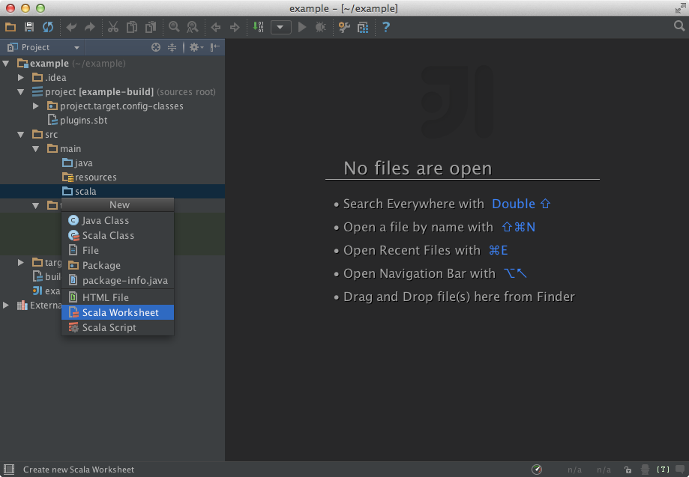
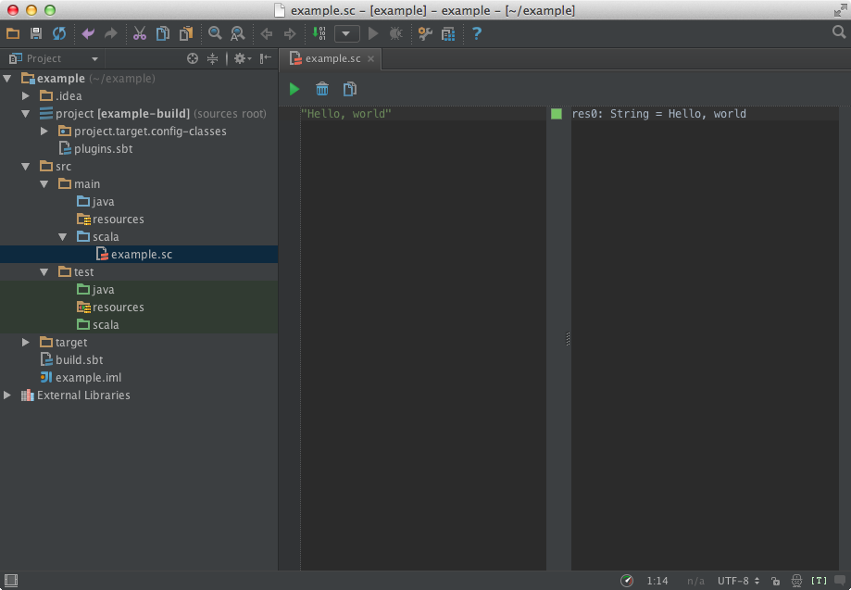
3. Creating a Scala worksheet
Simply use the Create New action from context menu or press Ctrl+N on a Scala source root.
To evaluate worksheets, use the corresponding toolbar icon, or press Alt+Ctrl+W (Alt+Cmd+W on OS X)

Slide 6
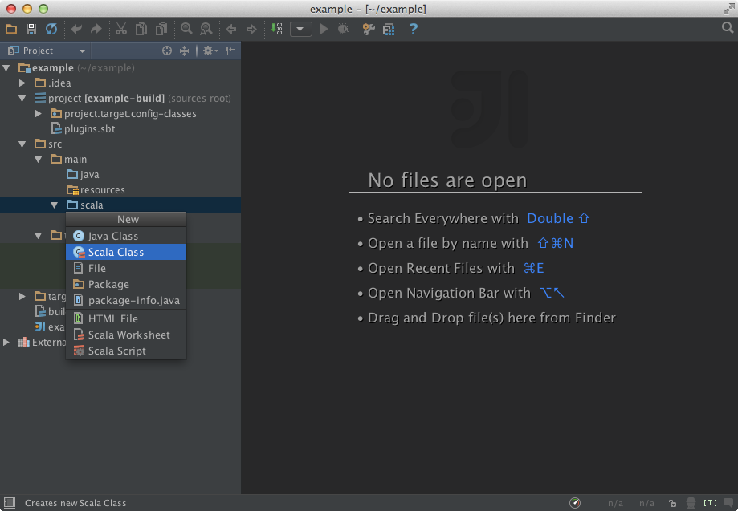
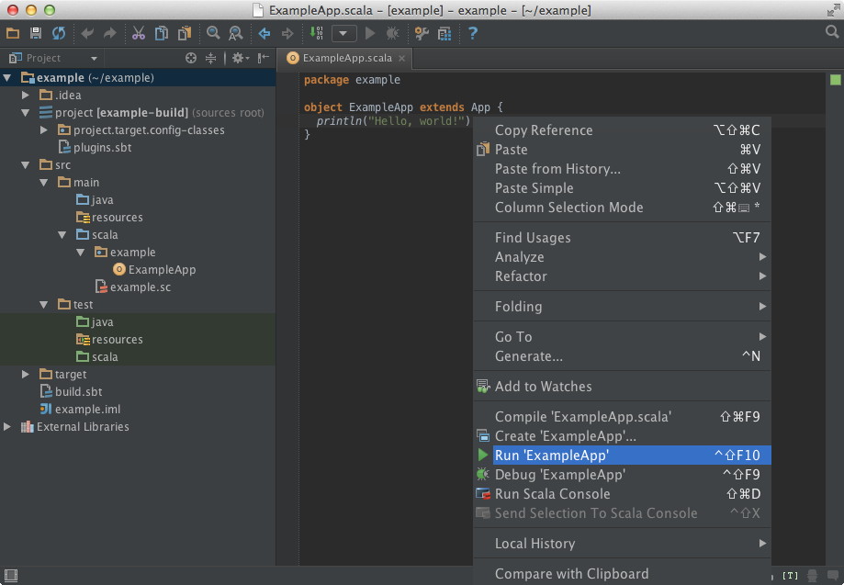
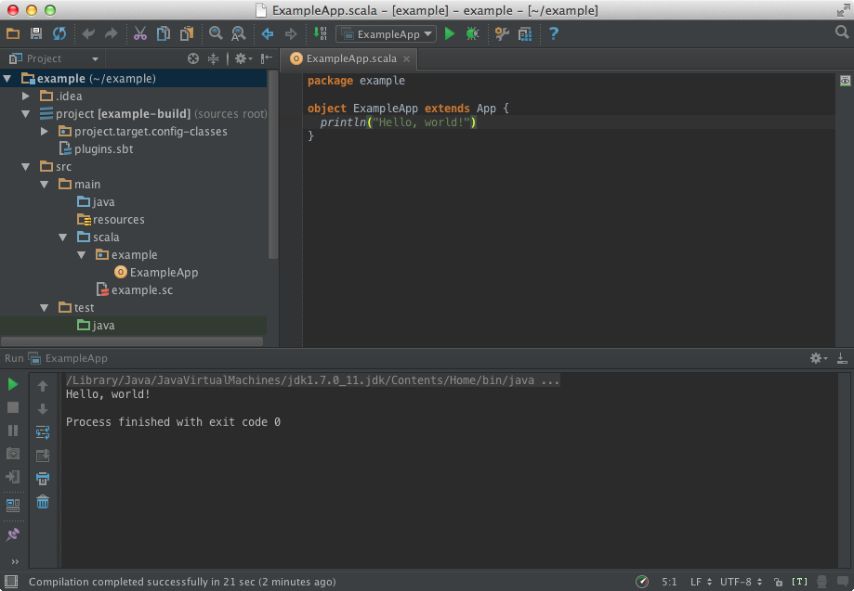
4. Creating a Scala class
Much akin to worksheets, Scala classes are created via context menu action Create New, or by using the Ctrl+N shortcut..
Once you are ready, run your application by pressing Ctrl+Shift+F10, or using the editor context menu.
After the application has finished running, you'll see its output in the Run tool window.

Slide 7
5. Opening an SBT project
To open an SBT project in IntelliJ IDEA, go to the Welcome Screen, click Import Project, and select SBT build file that you wish to open. IntelliJ IDEA will then create a new project and import the selected file to it.
Also, you can open an SBT project without calling the Import Project action. Just click Open Project from the Welcome Screen and select an SBT build file.

Slide 8
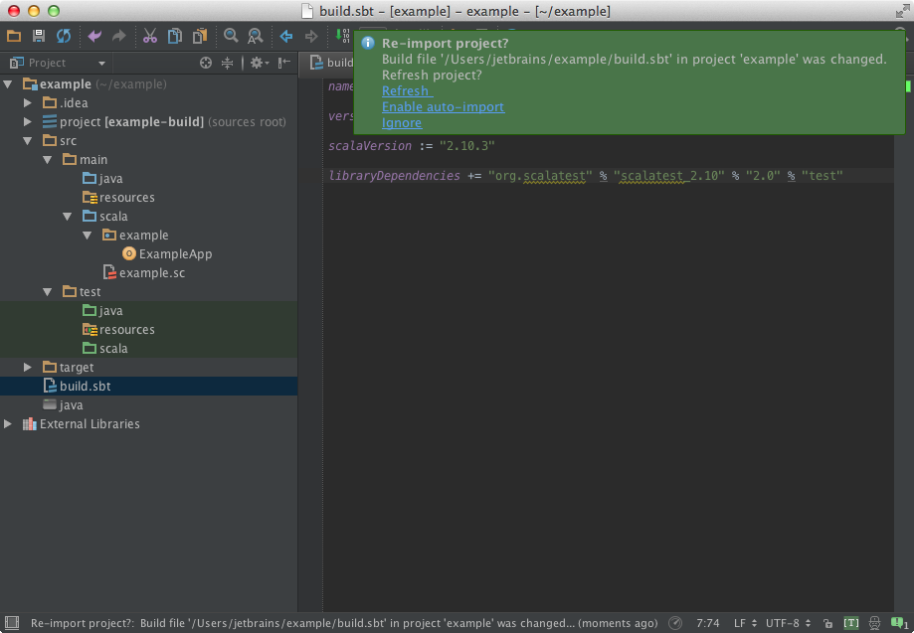
6.Synchronizing SBT and IntelliJ IDEA projects
IntelliJ IDEA SBT support synchronizes the project with your build file, so when you change Scala version you're going to use, or add a library, your project is updated accordingly.

Slide 9
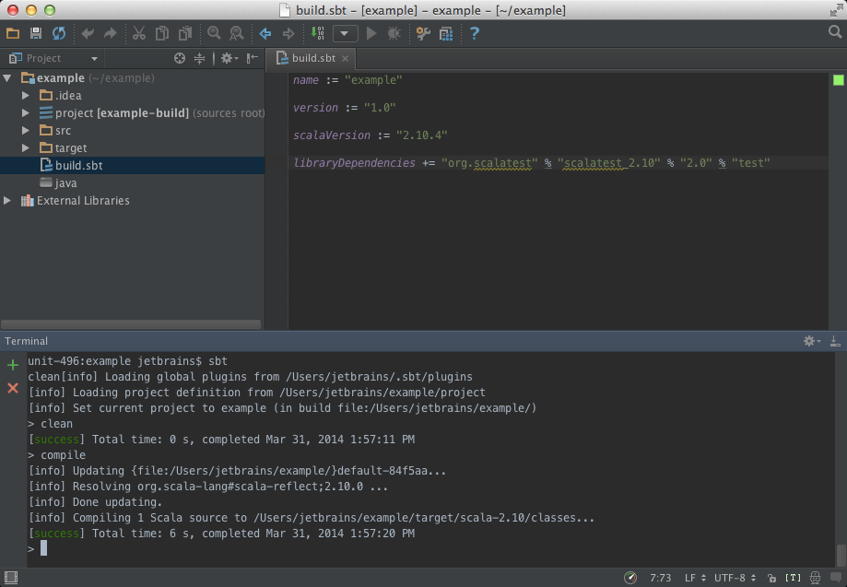
7. Using terminal to run SBT commands
The easiest way to run SBT commands from from IntelliJ IDEA is to use the Terminal tool window via Alt+F12.

Slide 10
References
IntelliJ IDEA quick start guide http://confluence.jetbrains.com/display/IntelliJIDEA/Quick+Start
Scala tutorials http://confluence.jetbrains.com/display/IntelliJIDEA/Scala+Development

